Slide 1

@MatthewYKnowles

Slide 4



Platinum Sponsors

Slide 5
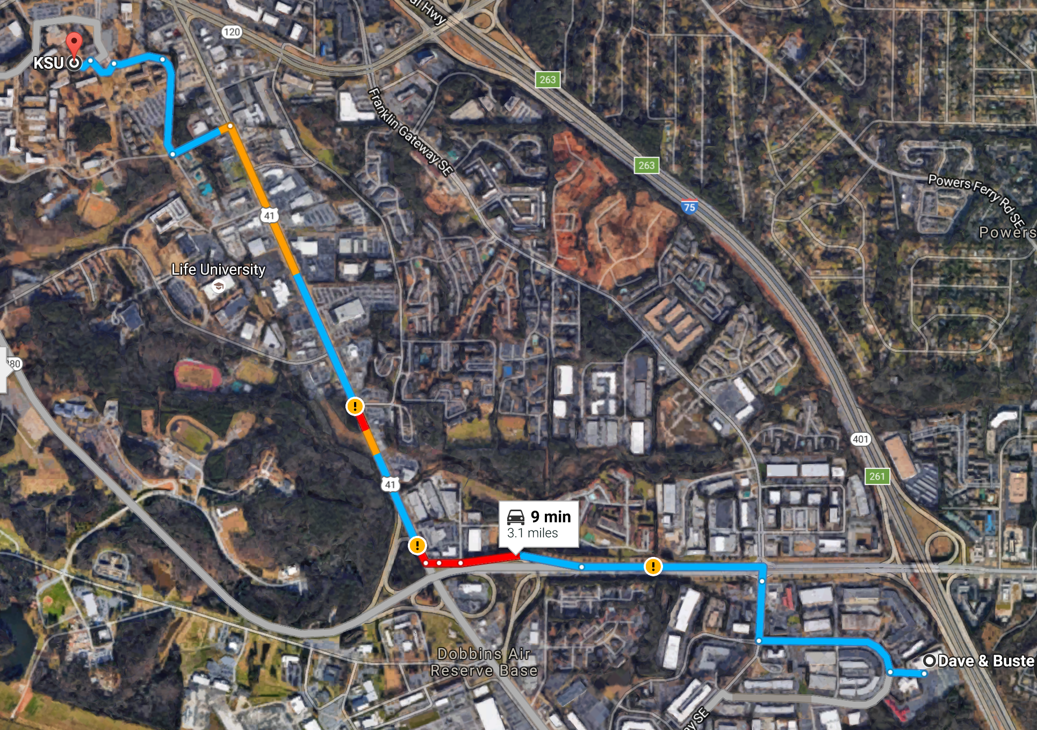

After Party – Dave & Busters
2215 D&B Drive Southeast Marietta, GA
Sponsored By:

Slide 6



Gold Sponsors
Silver Sponsors

Slide 7
@MatthewYKnowles
Notes:
Code Coverage
Mutation Testing

Slide 8



Software already Installed

Slide 9
Visual Studio Code
Config Changes
Save on pause
Format on save
Extensions
View in Browser

Slide 10
Tests

Slide 11
Why write tests?

Slide 12
Why Tests?
Verify functionality
Defend against unexpected change
When to write them

Slide 13
Code Coverage

Slide 14
How is coverage calculated

Slide 15
What does this tell you about your tests

Slide 16
Does this give you confidence to change your code

Slide 17

Add functionality to legacy code
Code Coverage
Limitations of code coverage
Mutation testing
Simple Design
New Functionality
Fowler blog post on JavaScript Refactoring
https://martinfowler.com/articles/refactoring-video-store-js/

Slide 18
How would you mutate this code?
1. a < b
2. a || b
3. a == b
4. if(a > b) {return a+b}
5. if(b > a) {a++}

Slide 19
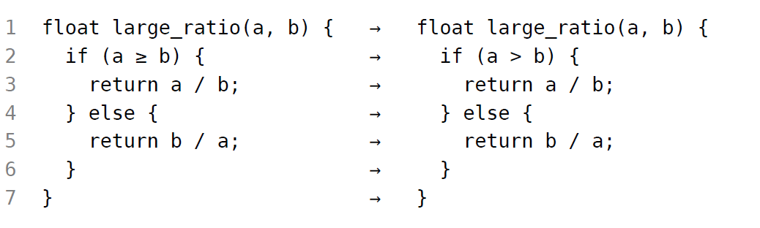
Equivalent Mutant

Slide 20
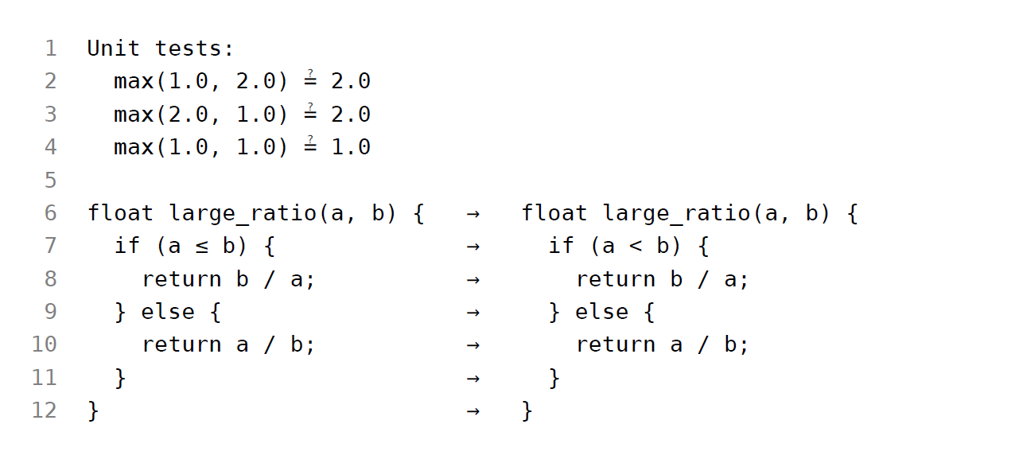
Equivalent Mutant

Slide 21


Slide 22
Mutation Testing
Injects changes into your code and expects a test to fail
More confidence in your test’s ability to detect code regression
Not all mutants are bad
When to run mutation testing
Mutation Testing Frameworks
Stryker – JavaScript
PiTest – Java
Visual Mutator – C#

Slide 23
As hard-nosed as I am about TDD as a necessary discipline; if I saw a team using mutation testing to guarantee the semantic stability of a test-after suite; I would smile, and nod, and consider them to be highly professional. (I would also suggest that they work test-first in order to streamline their effort.)
-Robert Martin (Uncle Bob)

Slide 24
Questions?
Special Thanks to:
Filip van Laenen – Mutation Testing: Better Code by Making Bugs
Martin Fowler - Refactoring
@MatthewYKnowles

Slide 25
New Functionality for Rental Store
Add a foreign movie to the rental store
Format the receipt for html instead of string
<h1>Rental Record for matthew</h1>
<table>
<tr><td>Cars 2</td><td>1.5</td></tr>
<tr><td>Dunkirk</td><td>9</td></tr>
</table>
<p>Amount owed is <b>10.5</b></p>
<p>You earned <b>3</b> frequent renter points</p>

Slide 26
Setup the Exercise
From the Command Line
$ git clone https://github.com/greatersum/refactoring-exercise-javascript.git
$ cd .\refactoring-exercise-javascript\
$ npm install
$ code .

Slide 27
Explore code and run tests
From the Command Line
$ npm test

Slide 28
Code Coverage
From the Command Line
$ npm install karma-coverage --save-dev
In Karma.conf.js
Add ‘coverage’ to reporters
Add 'src/**/*.js': ['coverage'] to preprocessors

Slide 29
Stryker Packages
"stryker": "^0.6.7",
"stryker-api": "^0.5.6",
"stryker-html-reporter": "^0.4.7",
"stryker-jasmine": "^0.2.7",
"stryker-karma-runner": "^0.4.5"

Slide 30
Stryker Config (stryker.conf.js)
module.exports = function (config) {
config.set({
testRunner: 'karma',
testFramework: 'jasmine',
coverageAnalysis: 'perTest',
reporter: ['html', 'progress'],
karmaConfigFile: 'karma.conf.js',
mutate: ['src/**/*.js']
});
}

